Slide 1
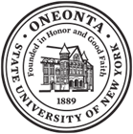
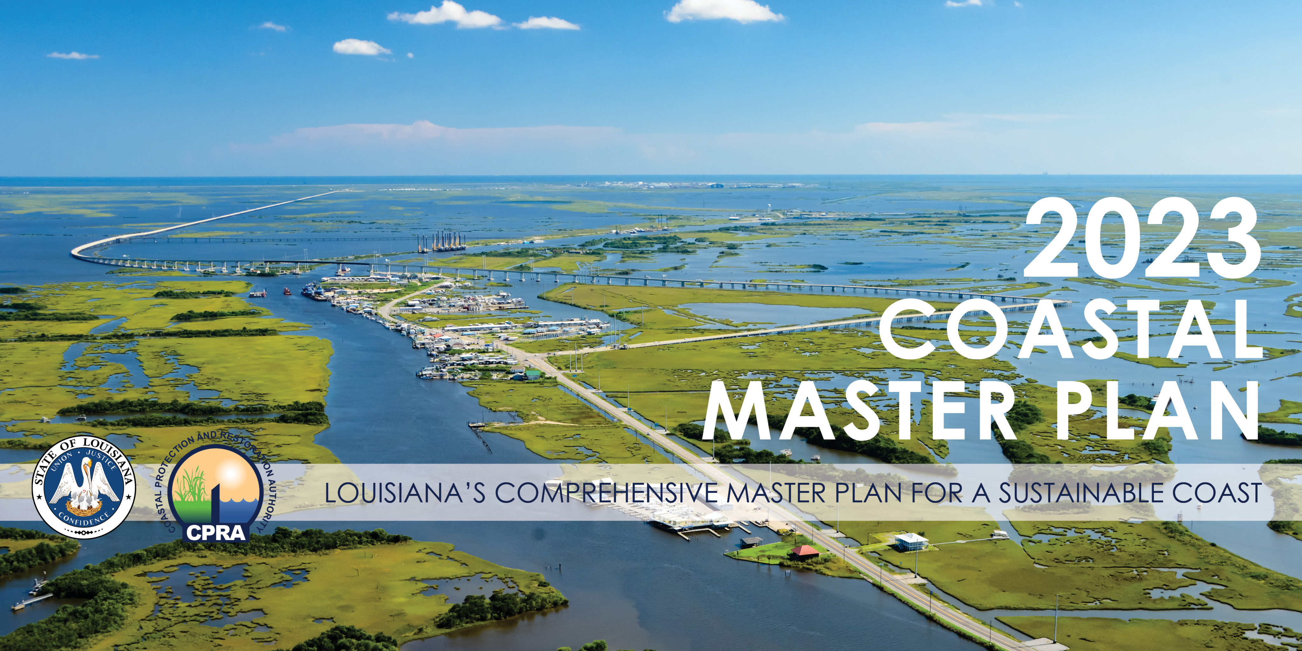
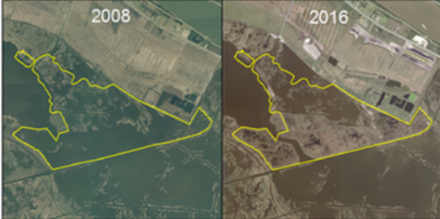
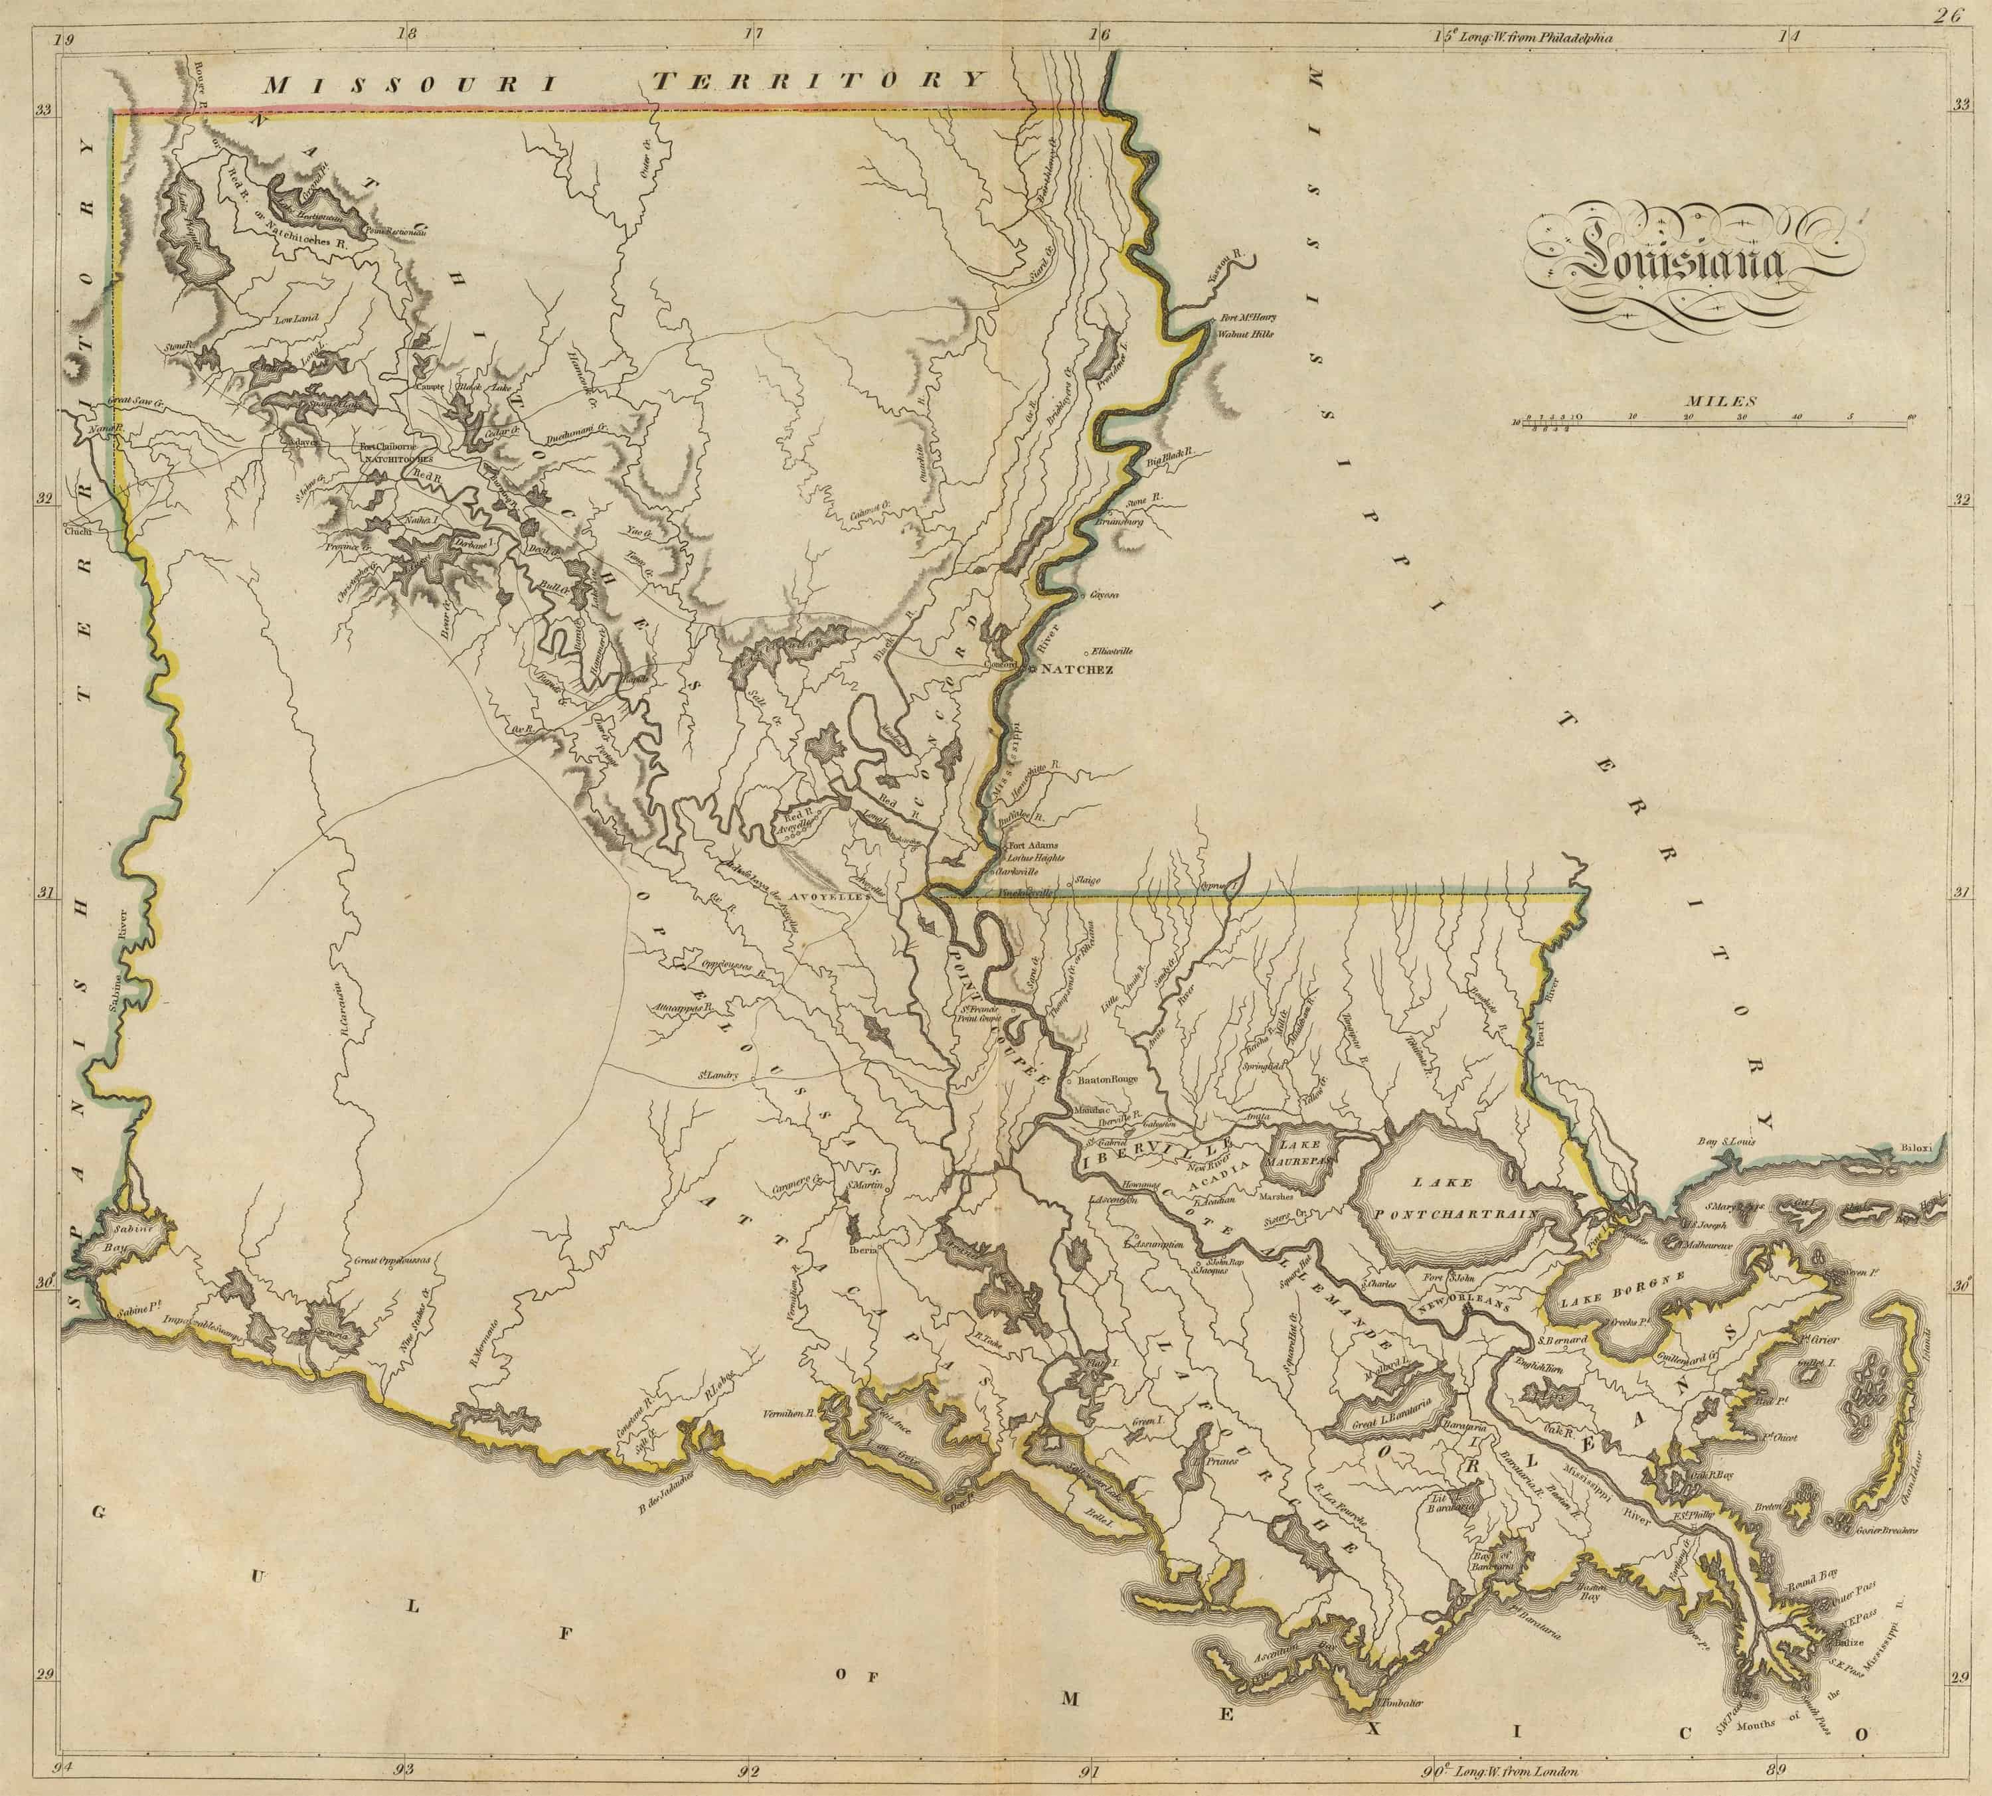
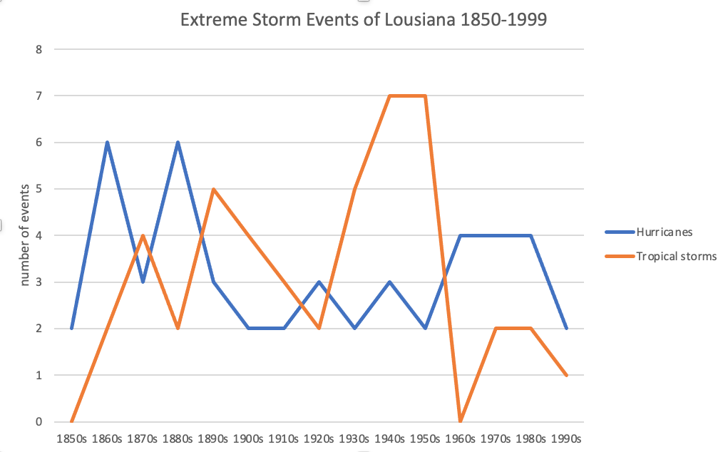
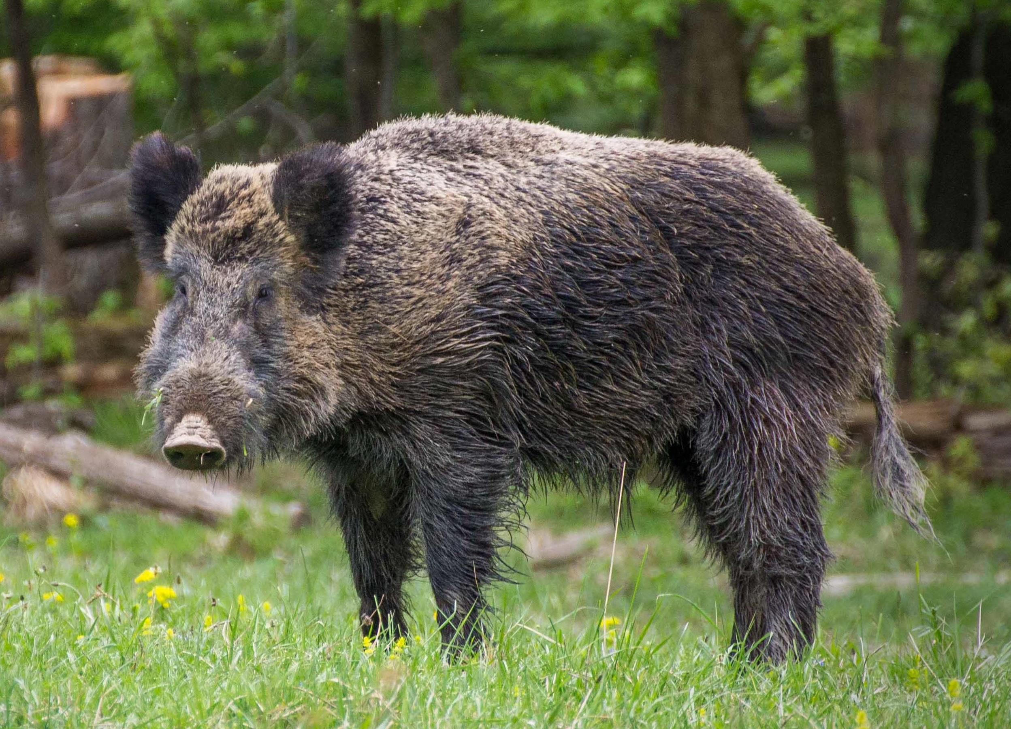
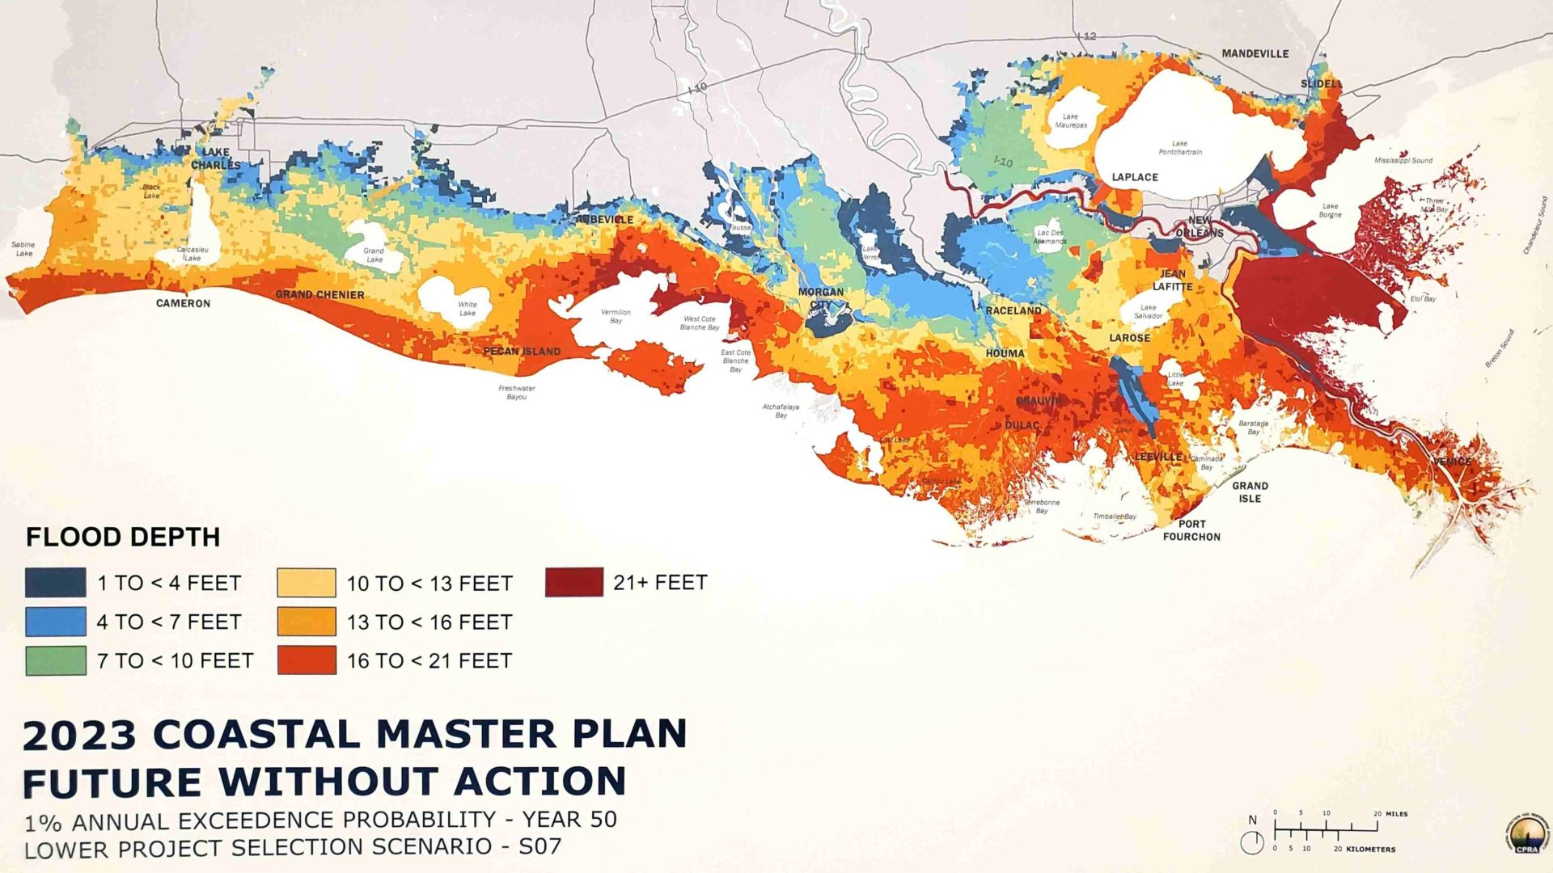
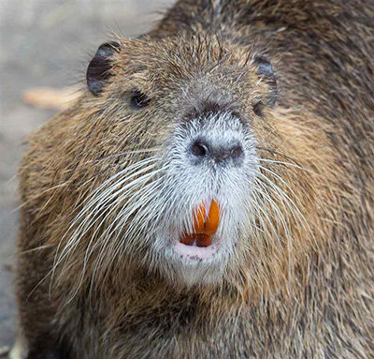
Land Loss of Coastal Louisiana: a Past, Present, and Future Analysis
Madalyn De Carr and Carlotta Batchelder
SUNY Oneonta GES Department
GEOG 4918: Disaster Geographies with Dr. Lascell
Abstract
The Present
Restoration Projects
Coastal wetlands are an integral part of the state of Louisiana, taking up about 2.5 million acres within the state. These wetlands are home to a plethora of flora and fauna and provide a natural barrier to the storm surges that frequent the area. Despite this, these diverse ecosystems are disappearing at an alarming rate due to human intervention, coastal erosion, and climate change. On average, the total land area lost is about as much as a football field every hour, which is the highest rate of wetland loss in the United States. This project is an investigative research poster that stresses the importance of researching how coastal land loss and its effects have changed over time in Louisiana. It will determine how these issues came about, how to properly conserve this land, as well as how to make more informed and constructive decisions for the future.
The current rate of land loss in coastal Louisiana is at about a football field every hour, which is the highest rate in the whole country. In Louisiana alone, wetlands loss accounts for 80% of the United State’s total wetland loss. The amount of land that coastal Louisiana has lost is dramatic. Since the 1930s, this state has lost an area of land roughly the size of Delaware. The barrier islands that protect coastal wetlands in Louisiana have also decreased in size, by more than 40%. If these rates continue, ecosystem health along with human life and property will be at stake (Coastal).
There is hope, however! Currently, many restoration projects are underway and plans on wetland management are being created. This can be seen in the image below, visualizing a recent restoration project named the Lake Hermitage Marsh Creation. This project created about 1,000 acres of wetlands.
Marsh restoration:
Wetlands can be reconstructed by planting marsh flora such as cypress trees, Spanish moss, and duck weed. Planting native vegetation fixes sediment, allowing the biome to become heathier and regain its previous biodiversity.
Ridge restoration:
Reestablishment of coast ridges fortify the coast in a way that blends with the surrounding natural environment, while also creating a high point that reduces storm surge and flood risk.
Barrier island maintenance:
Using dredged sediment, barrier islands can be maintained and rebuilt to provide habitats for flora and fauna while also protecting against storm surges.
Land bridge:
Land bridges are manmade marshes that would stretch across water basins much like a bridge parallel to the coast. These are beneficial as they would create some habitat and control sediment dispersal. This would also benefit nearby towns by reducing wave action inland.
Diversion:
Diverting water into separate basins would control floodwaters without the use of levees. This allows water and the sediment it carries to nourish wetlands and restore deltaic processes, while also benefiting industry by decreasing saltwater intrusion.
The Past
Louisiana wetlands are dependent on a cycle of river floods to receive sediment that allows growth and revitalization. The construction of levees and dams restrict the natural flow of rivers and cause sediment to deposit in different, unproductive ways. Dams starve the river downstream of sediment. Levees restrict the movement of rivers, and in the case of Louisiana, causes rivers to deposit sediment further downstream.
1900 Louisiana land map
Large scale storms such as hurricanes disrupt the natural flow of ecosystems through their high winds and unusually elevated and rough coastal waters. Storm surges can flood ecosystems and communities, as well as increase erosion.
Protecting Louisiana’s coastal wetlands and barrier islands is vital to protecting a variety of other things. Coastal wetlands protect the communities and infrastructure behind it by providing them with a natural storm surge and sea level rise barrier. If the Louisiana coast and its wetlands continue to degrade, many people’s homes and businesses will be increasingly at risk.
This region is also home to countless different species of plants and animals; Louisiana's coastal wetlands is one of the most productive ecosystems in North America. Over 400 different types of birds live in coastal Louisiana, and millions of others make a stop there when migrating (What’s).
Invasive Species
Invasives have adverse effects on land loss as they destroy vegetation by consuming it or by trampling the ground. This loss of vegetation increases erosion as sediment has nothing to latch onto, so it is carried away by water and wind.
Putting these plans into action requires a massive amount of funding. Hydraulic restoration would require an estimate of $230 million, ridge restoration $37 million, marsh restoration $16 billion, land bridges $2.9 billion, diversion $2.7 billion, and both structural and nonstructural risk reduction would add up to $25 billion. $460 Million for integrated projects that aren't detailed but have funds allocated for when they arise.
Nutria were released accidentally into the Louisiana wild during a hurricane. While these rodents helped the fur trade economy, they have harmful effects on wetland ecosystems. Nutria rapidly reproduce and feed on the roots of marsh plants such as cattails, salt meadow cordgrass, Olney three-square, and cypress seedings.
The Future
It is predicted that sea levels will continue to rise in the future, thus worsening land loss on a global scale. The rate at which sea levels are going to rise and its severity are still debated, however. One prediction states that sea levels could increase by 2.5 feet by 2025, another predicts a rise of 1.6 feet by 2073. Total land lost on the Louisiana coast could be anywhere between 1,500 square miles to 3,000 square miles by 2073. This could cause an increase in the frequency and severity of floods, leading to even inland areas such as Donaldsonville and Jennings, Louisiana, to experience flooding above 21 feet by 2073. Despite this, there are many efforts being made in the present to offset these effects alongside plans for future management. These could lead to between 74 to 120 square miles of land loss to be avoided by 2073.
Brought to Chalmette originally, feral hogs have adapted to thrive in a variety of environments. Hogs have a high reproductive rate, making population control difficult. These mammals uproot and trample vegetation, and their heavy consumption of fruit, nuts, and berries slow natural reforestation.
Predicted 2073 flood depths if no action is taken

Slide 2
“Census.gov.” Census.gov, https://www2.census.gov/prod2/decennial/documents/41033935v15-21ch3.pdf.
“Feral Hogs.” Feral Hogs | Louisiana Department of Wildlife and Fisheries, https://www.wlf.louisiana.gov/page/feral-hogs.
National Weather Service. https://www.weather.gov/media/lch/events/lahurricanehistory.pdf.
“Our Coastal Crisis - Restore the Mississippi River Delta.” MississippiRiverdelta.org, Restore the Mississippi River Delta, https://mississippiriverdelta.org/our-coastal-crisis/.
Include research questions, state that its an investigative research poster!!!

Slide 3
Coastal land loss in the Mississippi River Delta. Restore the Mississippi River Delta. (2017, July 20). Retrieved April 11, 2023, from https://mississippiriverdelta.org/our-coastal-crisis/land-loss/
Hazards-Coastal Erosion. Coastal Erosion - NOLA Ready. (n.d.). Retrieved April 11, 2023, from https://ready.nola.gov/hazard-mitigation/hazards/coastal-erosion/
What's at risk: Wildlife | restore the Mississippi River Delta. Restore the Mississippi River Delta. (n.d.). Retrieved April 11, 2023, from https://mississippiriverdelta.org/whats-at-stake/wildlife/

