Slide 1


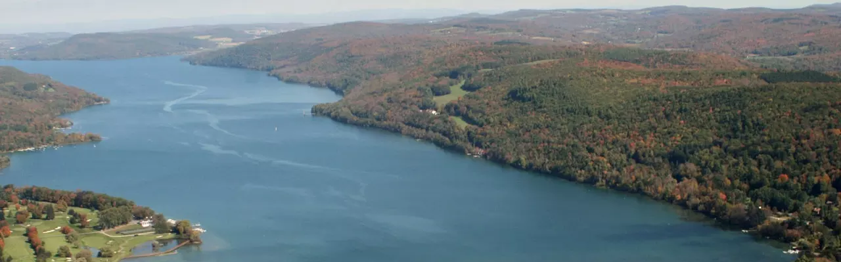
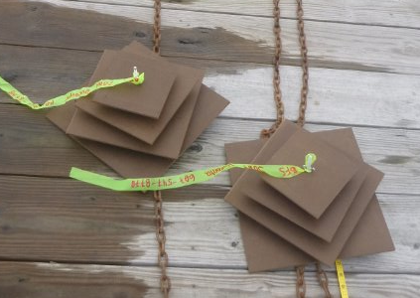
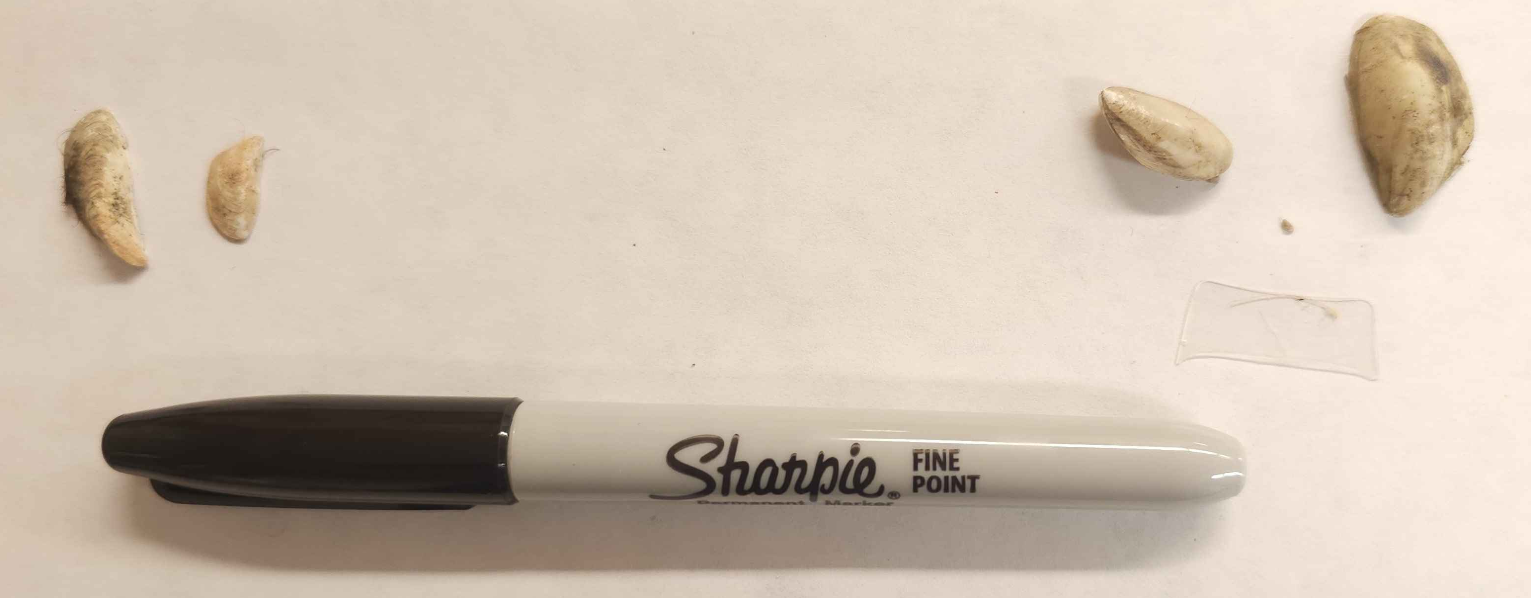
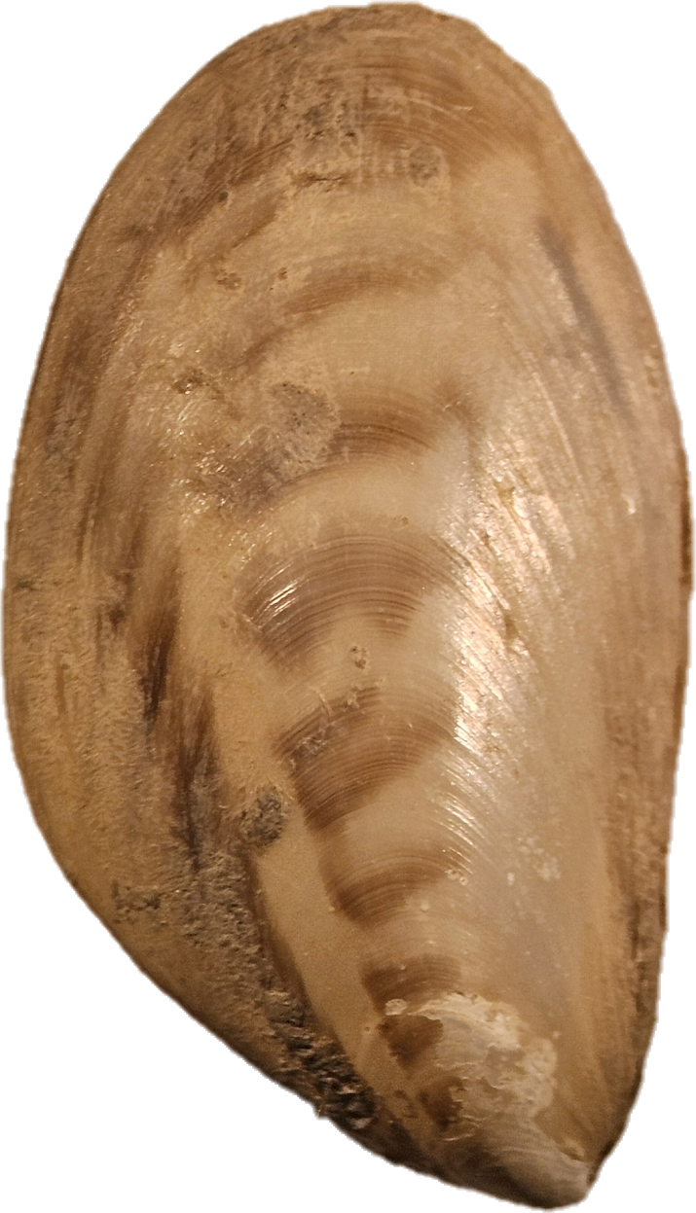
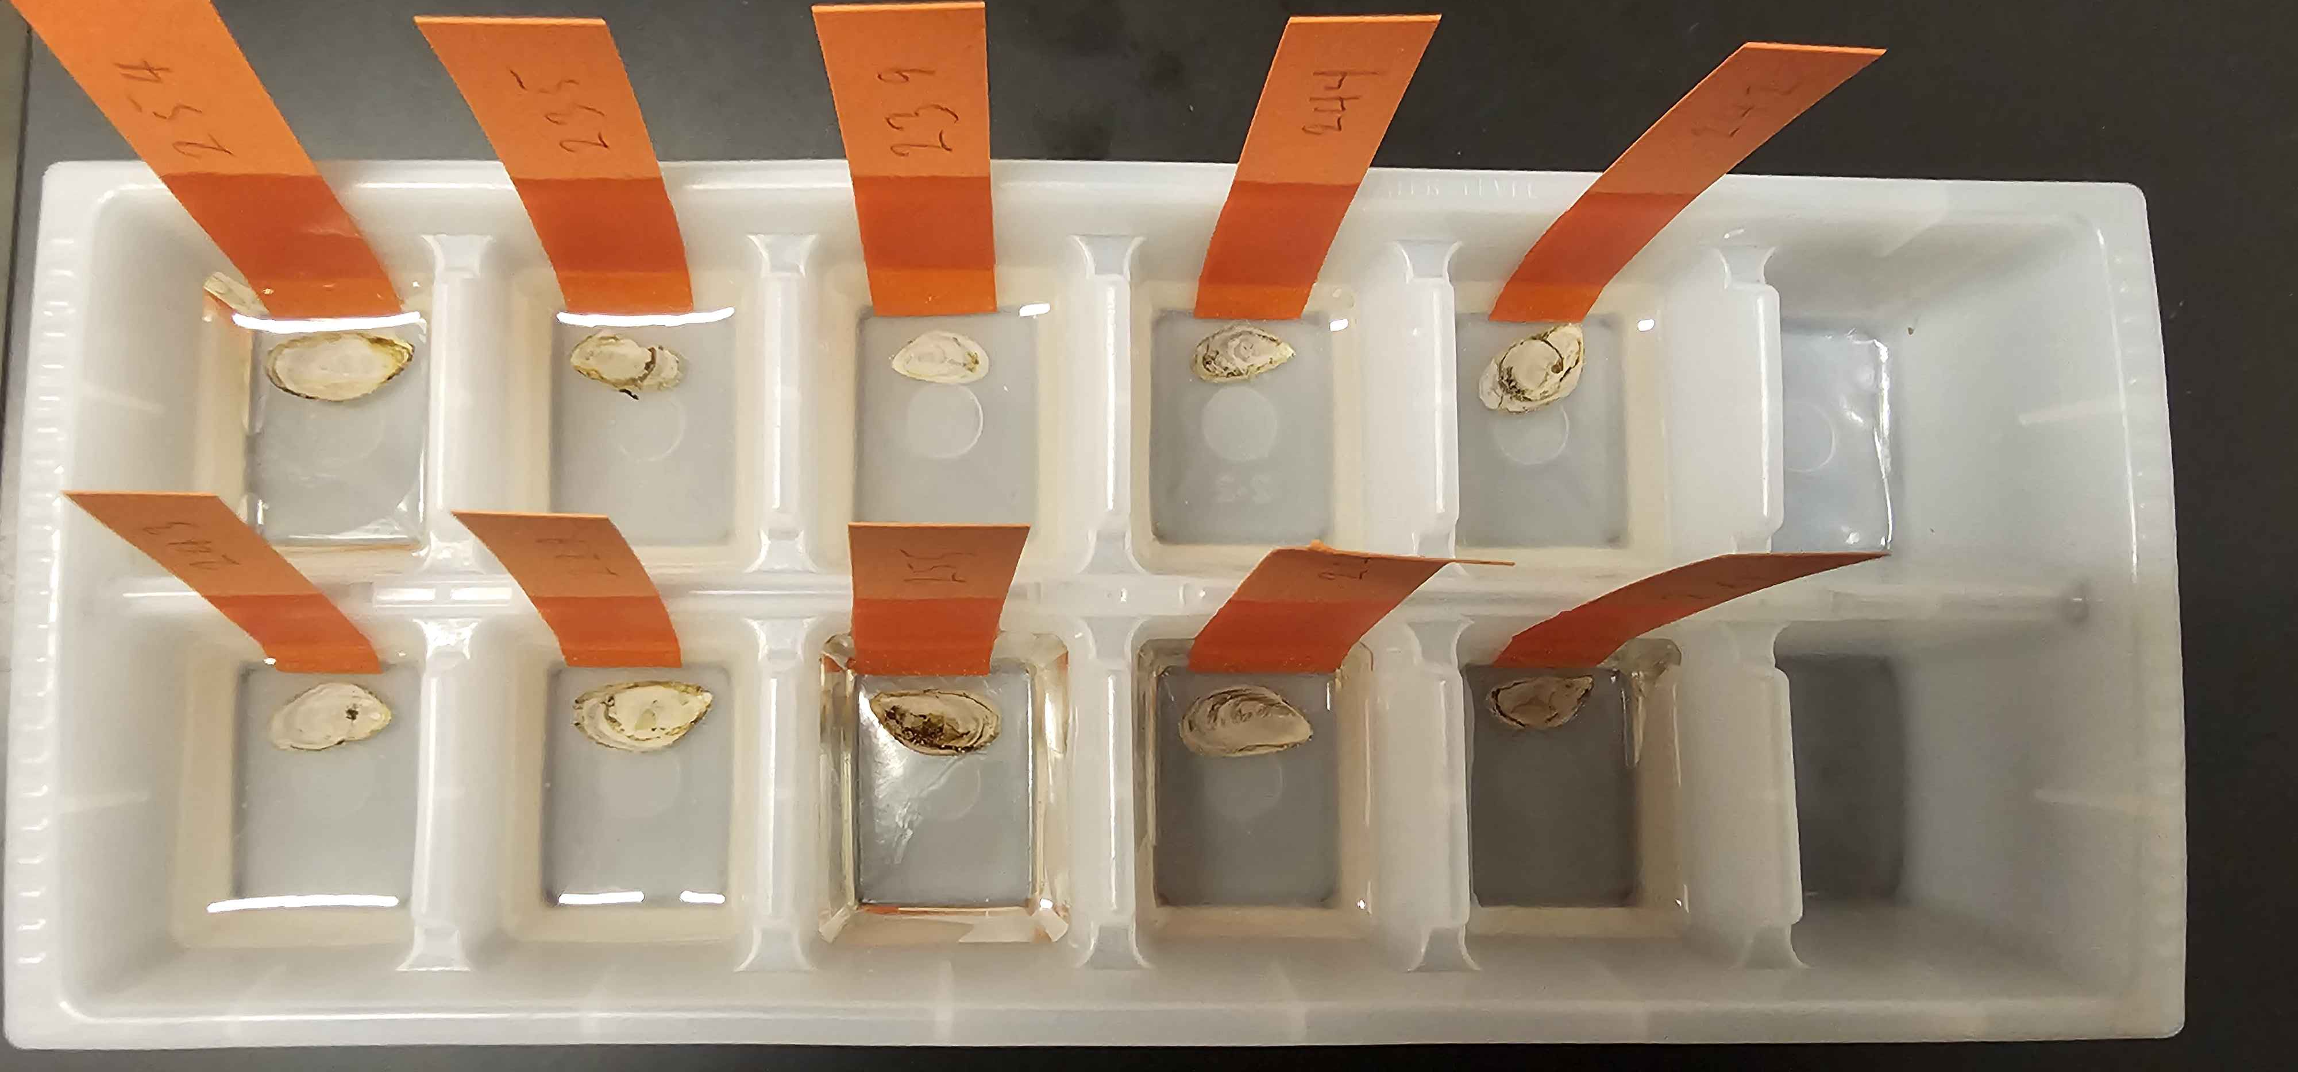
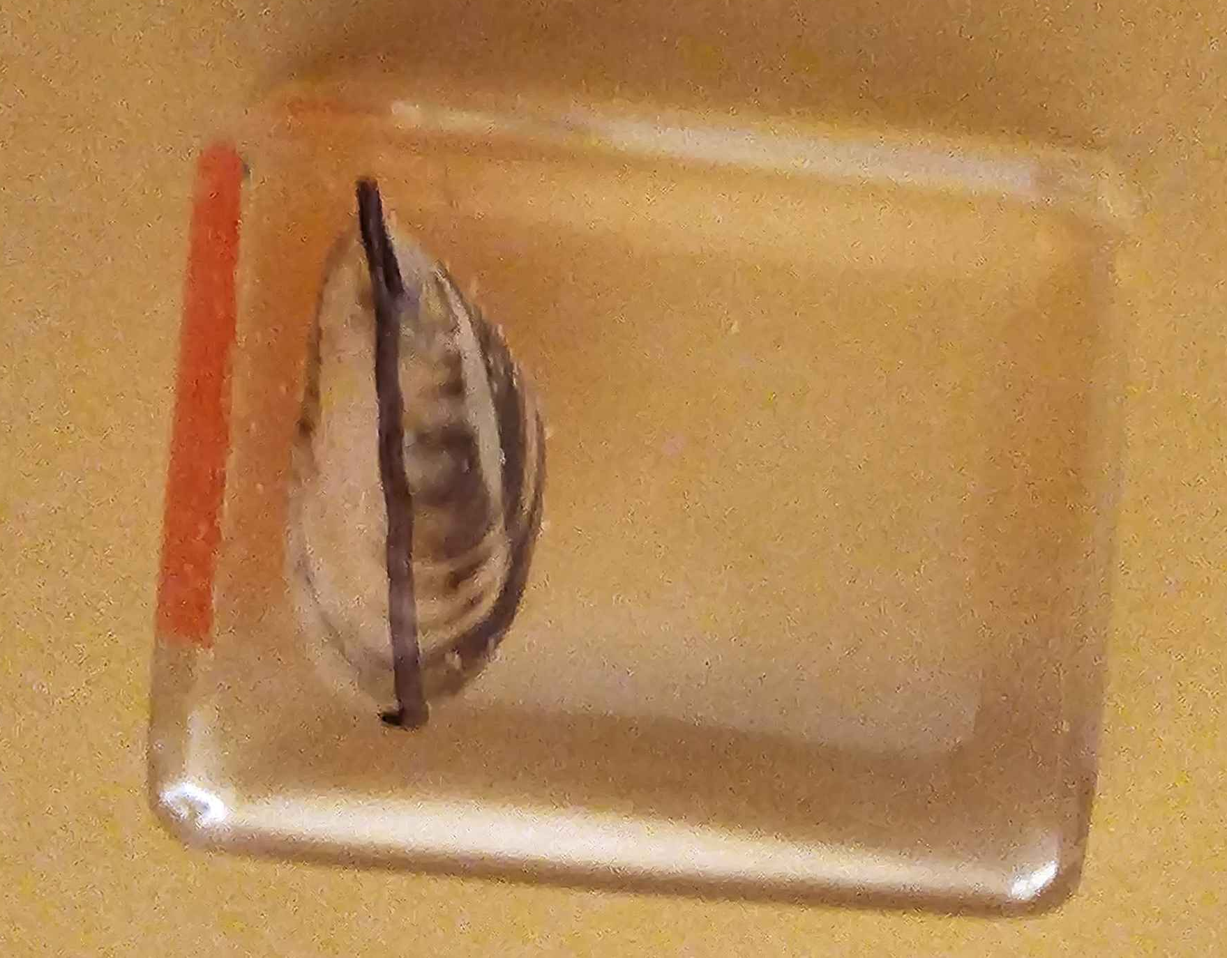
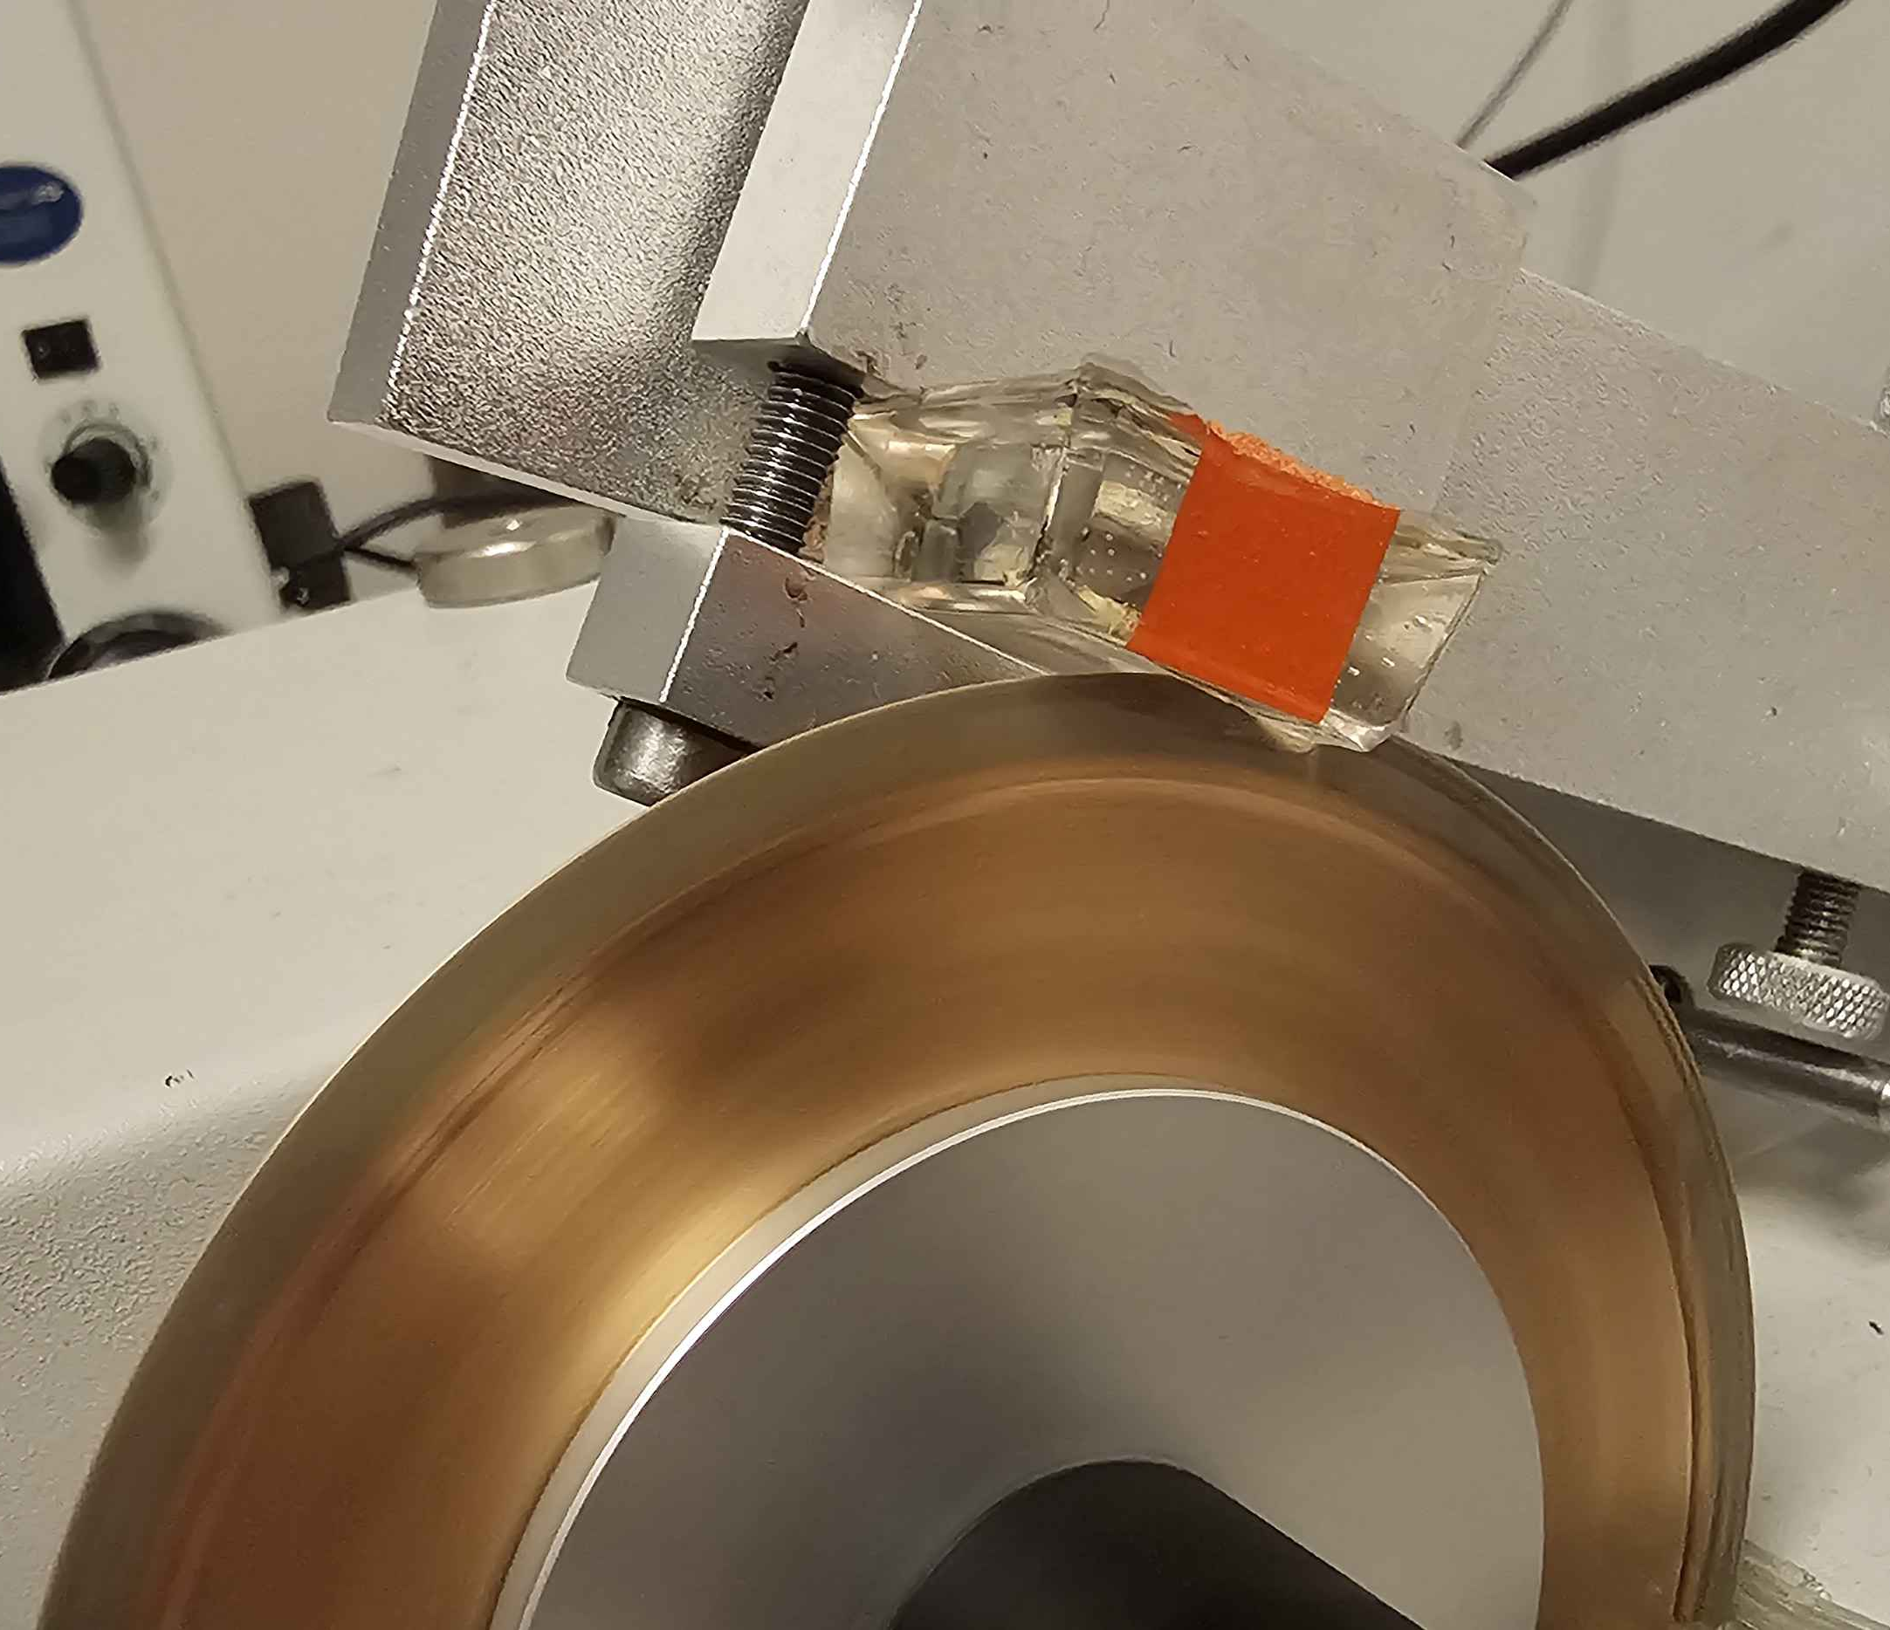
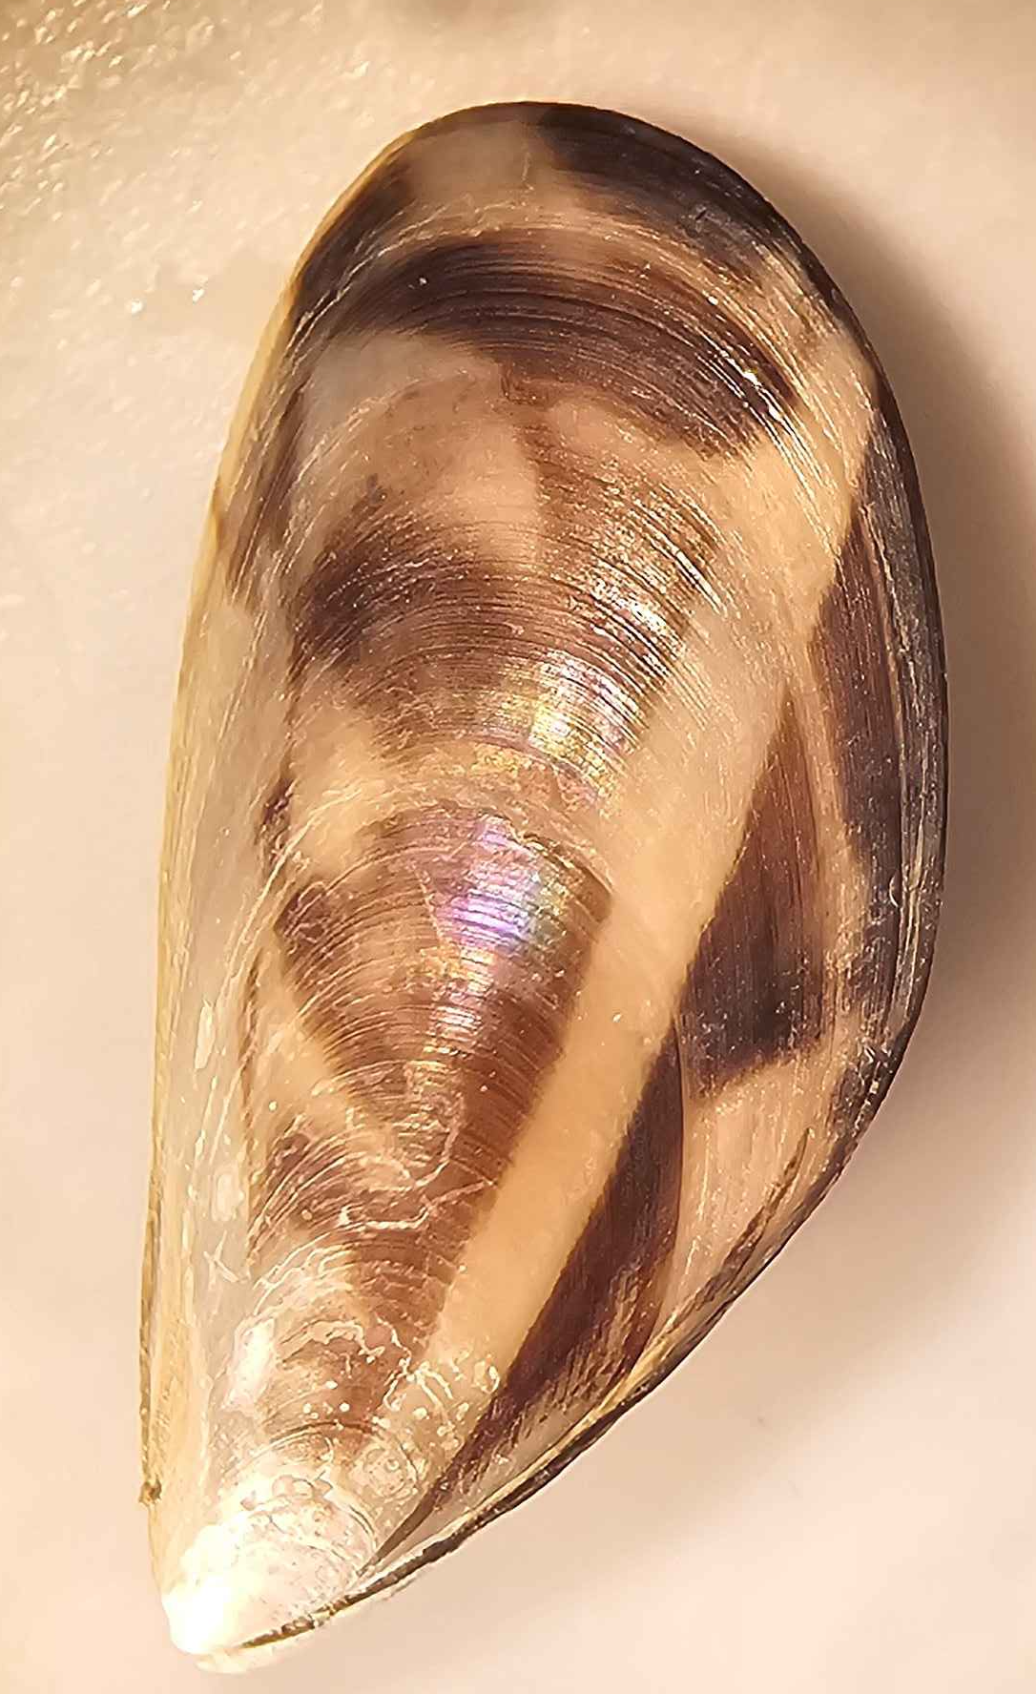
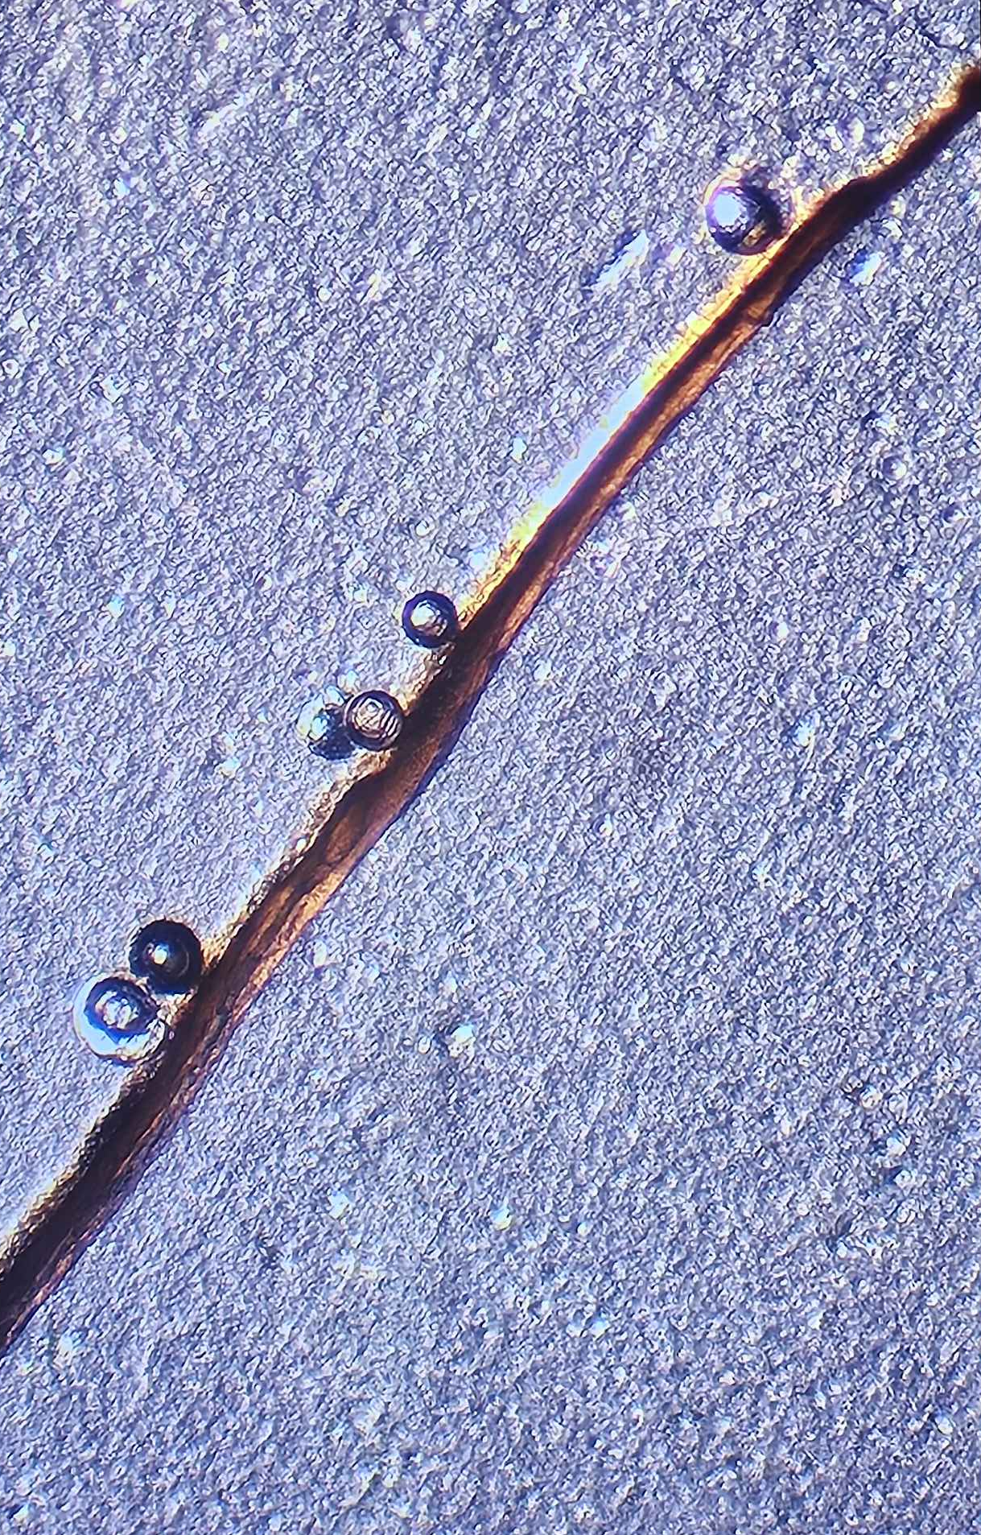
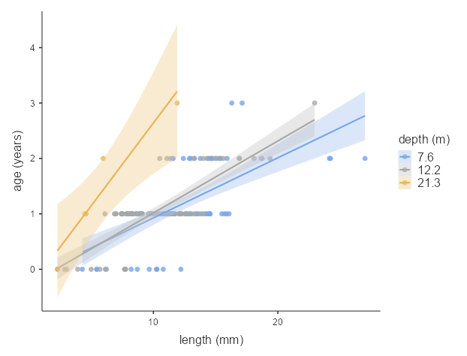
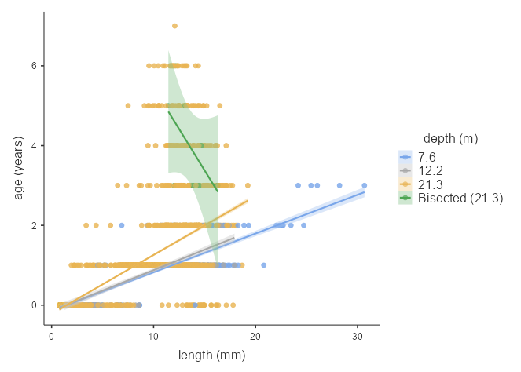
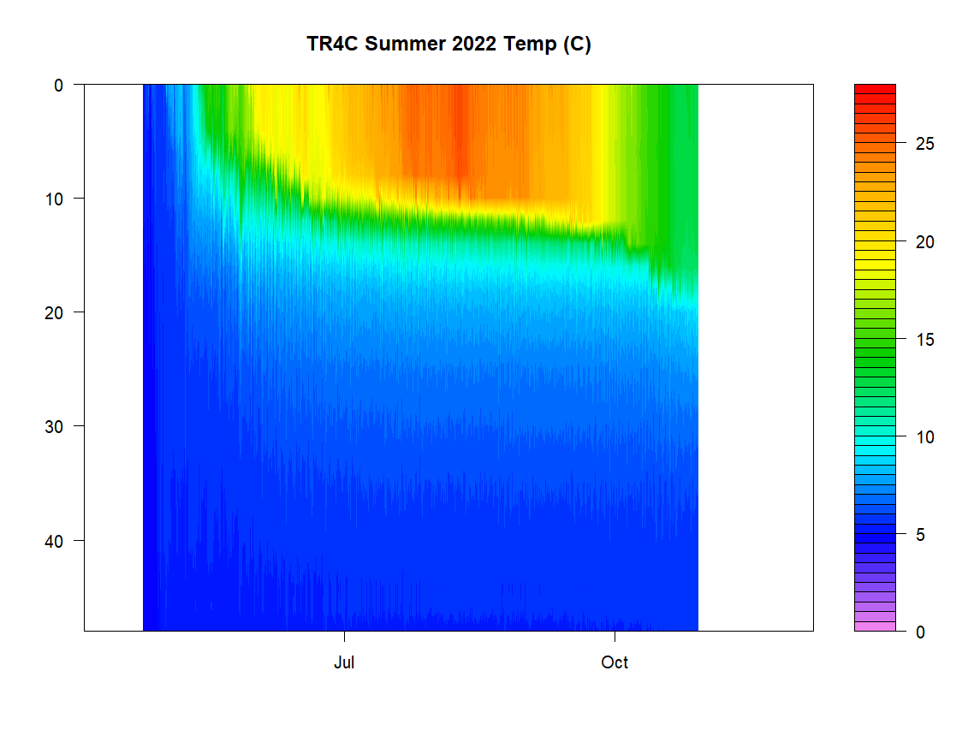
Invasive Mussel Populations in Otsego Lake and the Temperatures they Experience
Bast (Jordan) Corsette (Physics) and Kiyoko Yokota (Biology)
About the Lake:
Otsego Lake has been a key focus for study because of its relatively recent colonization by two invasive mussel species. Quagga and Zebra mussels have been found growing in many lakes outside eastern Europe where they originate, and their presence significantly alters the food web of locations they invade.
Otsego Lake has also been experiencing decreasing ice cover across the winters, which also alters the lake’s ecosystem.
Invasive mussels found at lower depths in Otsego Lake tend to be older for their size, suggesting slower growth.
Otsego Lake | https://suny.oneonta.edu/biological-field-station/otsego-lake
Characteristics of the lake in units of length:
2 half-shells from Zebra Mussels (left), and 3 intact Quagga Mussels (right) and 1 bisected shell
Area
16.37 km²
4046 acres
Length
12.6 km
7.8 miles
Max depth 50.5 meters
165.7 feet
Mussel Collection Devices |
Stickney S, Yokota, Kiyoko. 2021. Assessment of Invasive Quagga Mussel Populations and Forced Circulation Devices on Lake Water Temperature in Otsego Lake, NY. SUNY Open Access Repository. http://hdl.handle.net/20.500.12648/1839.
Zebra Mussels (Dreissena polymorpha) found in Otsego Lake 2007.
Quagga Mussels (Dreissena bugensis) found in Otsego Lake 2020.
Our Process:
Invasive Mussels of Otsego Lake:
A project started in 2021 by SUNY Oneonta undergraduates: Riley Smith, Sierra Stickney, Kari Minissale, mussel collectors were created then deployed at several depths near the shore, twice in 2021 and again in 2022.
Over 8000 mussels have been collected, identified, sized, and aged by their annual ring formation. This project uses the most recent collection from 2022.
Because of the difficulty of finding the annual rings on some mussels, we took a sample from the 70-foot collection depth to be bisected with the support of Brian Hefferon at SUNY Cobleskill (process illustrated right).
Based on measured ages of mussel samples, the Quagga species could have been introduced as early as 2017. Quagga is currently the dominant mussel species in Otsego Lake.
Depth
Bisection Process:
Strengthen samples (Done by encasing mussels in resin)
Mark desired cutting line, to get best view of growth marks
Cut thin chip using slow-speed saw
Provides a second reference on the age of the mussel.
Temperature of Otsego Lake:
Yokota Lab members managed high-frequency temperature logging chains deployed in the Summer and Winter located at a point referred to as TR4C in the center of the water body. The max depth the chains logged was at 49.5 meters (162.2 ft).
Utilizing a package written in R, called Gleon RLakeAnalyzer, we created heatmaps out of the information gathered by the temperature chains.
Time
Significance:
There is less data on Zebra mussels collected in set 3, leading to a larger range in its confidence intervals. The age vs. length graphs of both mussel species indicates that mussels living lower in the lake are smaller with their age, though the correlation isn’t as distinct between 40 and 25 feet compared to 70-foot collection depth.
The TR4C heatmap collects data from the center of the lake, but because of the location difference between TR4C and the mussel collection site, the temperature of TR4C doesn’t necessarily indicate those experienced by the mussels. The data suggests the mussels may grow slower in deeper parts of the lake.
Details of methods available on request.
Acknowledgements:
The project founders: Riley Smith, Sierra Stickney, Kari Minissale
Others who have been directly involved with the collected mussels and their identification: Madelynn Ackley, Erika Ligouri, Sarah Frueh
Brian Hefferon for his support and for providing services to perform bisection
And to: BFS Volunteer Dive Team, Belmonte-Flynn Family, VanHeusen Family, BFS for boats and dock access, SUNY Oneonta Student and Faculty Research Grant Programs, Student Research and Creative Activity Grant
Regression line confidence intervals created using the Standard Error option in Jamovi
Zebra Mussels Length
Quagga Mussels Length

